Slide 1
be caught up in sth: be absorbed or involved in sth, especially an unwelcome situation
被卷入；被陷入 (=be involved in sth)
She was caught in a heavy storm.
I didn’t want to be caught up in endless unimportant arguments.
我不想陷入无休止的无关紧要的争论中。
catch sb doing sth
catch on catch up on sth
突然遇上
当场发现某人做某事
流行
补上；补做

Slide 2
1) 对不起，我迟到了—— 我遇上交通堵塞了。
2) 真幸运，我们家乡没有卷入战争中。
3) 真难为情，他考试作弊被逮了个正着。
It’s a shame that he was caught cheating in an exam.
4) The idea of book-sharing has been around for ages
_________________. (没有真正流行起来)
5) I burned the midnight oil last night and now I just want to
____________________ (我昨晚熬夜了，现在只想补点觉。)
Sorry I’m late – I was caught in the heavy traffic.
It’s lucky that my hometown wasn’t caught up in the war.
without catching on
catch up on some sleep.

Slide 3
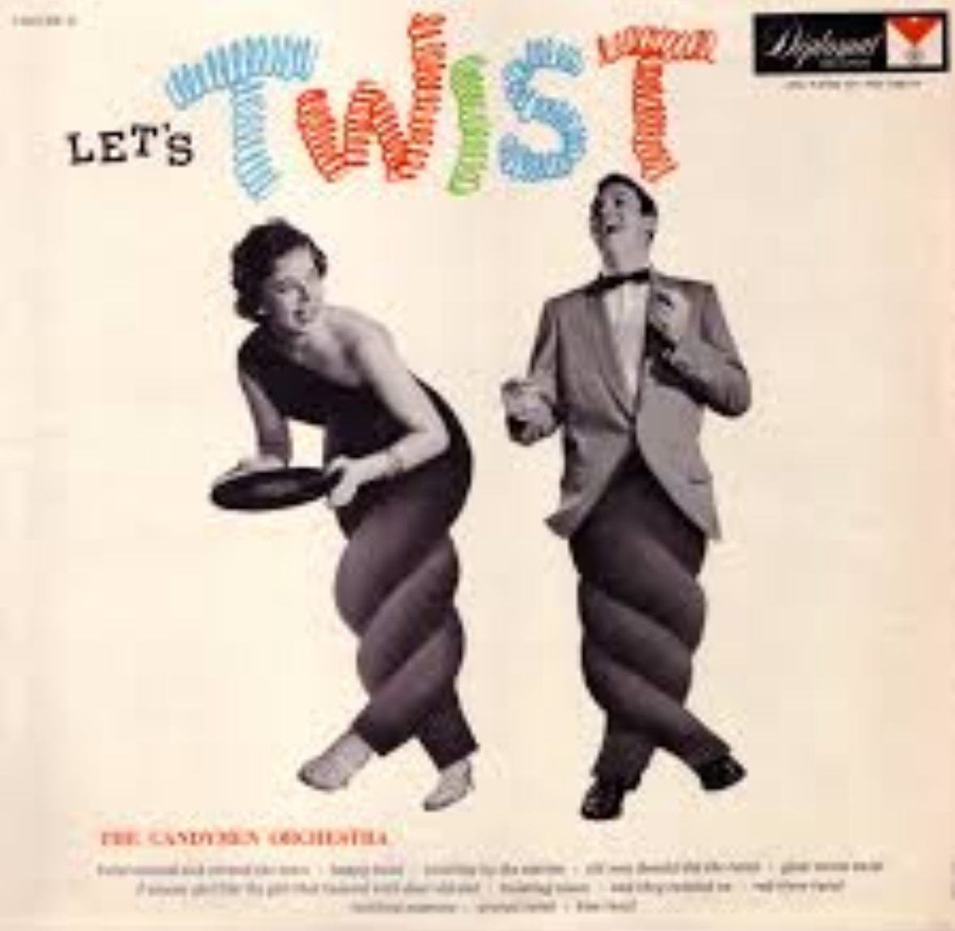
He twisted his head around to look at her.
他扭过头去看她。
Nervously I twisted the string on my hoodie.
我紧张地转着连帽衫上的绳子。
Twist the knob to the left to open the door.
向左转动手柄把门打开。
twist off the lid/cap 旋开瓶盖

Slide 4
The road twists and turns along the coast.
道路沿着海滨蜿蜒曲折。
狭窄弯曲的街道
The newspaper was accused of twisting the facts.
这家报纸被指责歪曲事实。
the twists and turns of his political career (n.)
他政治生涯的一波三折
(... of the mountain road / ... in the story)
narrow twisting streets

Slide 5
Keep your stuff close and stay away from vehicles.
stuff un.
All my stuff was lost due to my carelessness.
I like reading and stuff. (之类的)
stuff v.
1) 装满，填满
stuff 500 leaflets into envelopes / stuff 500 envelopes with leaflets
All the drawers were stuffed with/full of letters and papers.
所有抽屉里都放满了信函文件。

Slide 6
stuff v.
2) to push sth quickly and carelessly into a small space 把…塞进（或填进）
She stuffed the money under a cushion.
她把钱塞到软垫底下。
His hands were stuffed in his pockets.
他两手插在口袋里。
3) 给…装馅
Are you going to stuff the turkey?

Slide 7
motor vehicles 机动车辆
vehicle n. something that can be used to express your ideas or feelings or as a way of achieving sth （赖以表达思想、感情或达到目的的）手段，工具
Art may be used as a vehicle for expressing yourself.
艺术可以用作表达自己的工具。

Slide 8
Important phrases
1. 发生
2. 乔装打扮
3. 根据
4. 留下印象
5. 使想起
6. 绝不；根本不
7. 携手；联手
8. 笨手笨脚
9. 下车（飞机、船）
1. take place
2. dress up
3. according to
4. make an impression
5. remind … of
6. anything but
7. join hands
8. have two left feet
9. get off

Slide 9

10. 难怪
11. 亲自
12. 及时；迟早
13. 即将; 正要
14. 就座；代替
15. 立刻行动
16. 一路上
17. 一波又一波的
18. 被卷入；被陷入
19. 这么说吧；大致说来
10. no wonder
11. for oneself
12. in time
13. be about to do
14. take one’s place
15. jump into action
16. all the way
17. wave after wave of
18. be/get caught up in
19. let’s just say

